Slide 1
Automated Mentee Mentor matching - Algorithm Presentation
What did the data say to the mentor?
I feel like I’m just not getting the right insight!
Presented by Arani Bosire

Slide 2
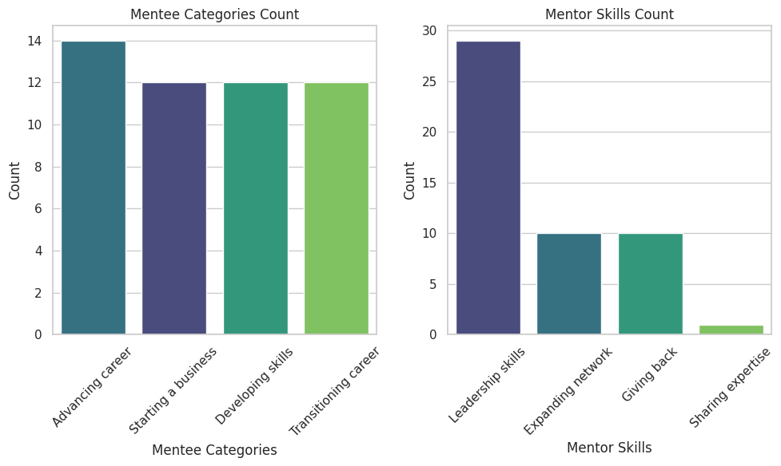
Data Overview - Summary of mentor and mentee demographics and profiles.
Summary of Total Matches
Total Matches: 50
Mentee Categories Count:
- Advancing Career: 14
- Starting a Business: 12
- Developing Skills: 12
- Transitioning Career: 12
Mentor Skills Count:
- Leadership Skills: 29
- Expanding Network: 10
- Giving Back: 10
- Sharing Expertise: 1

Slide 3
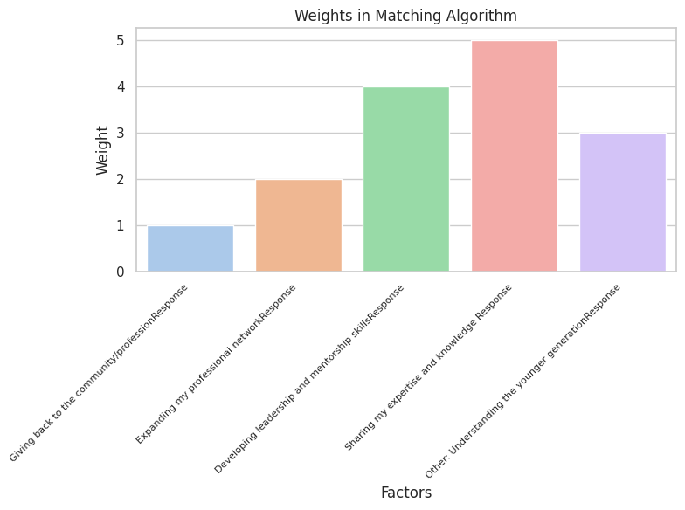
Matching Algorithm & Weights
Explanation of the proprietary matching algorithm.Overview of weighted factors used in the matching process.
The algorithm pairs mentees with mentors based on their goals and expertise while assigning weights to key factors that influence match quality.
Weighted Factors
- Giving back to the community: 1
- Expanding professional network: 2
- Developing leadership skills: 4
- Sharing expertise: 5
- Understanding the younger generation: 3

Slide 4
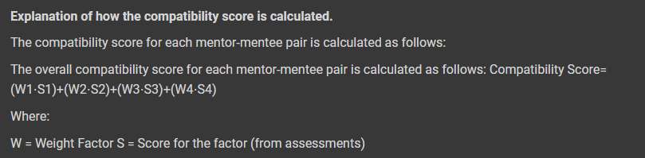
Match Types & Compatibility Score Calculation
Scores range from 0 to 10, with higher values indicating better matches: above 8 is excellent, 6-8 is good, 4-6 is fair, and below 4 is poor.

Slide 5
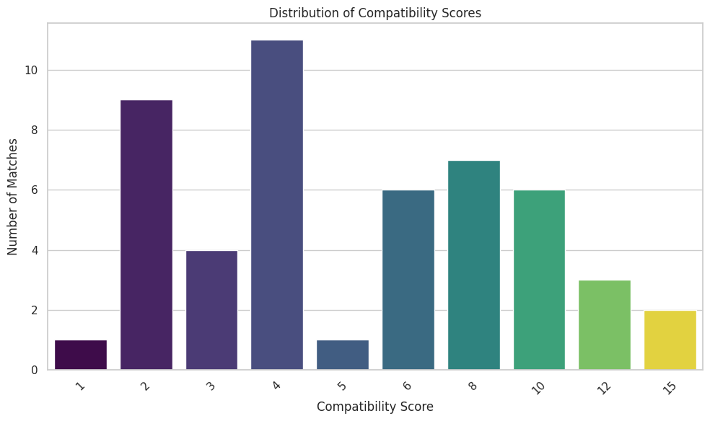
Analytics of Match Outcomes
The bar chart indicates a concentration of compatibility scores around 4, suggesting many moderate matches but fewer extreme scores.

Slide 6
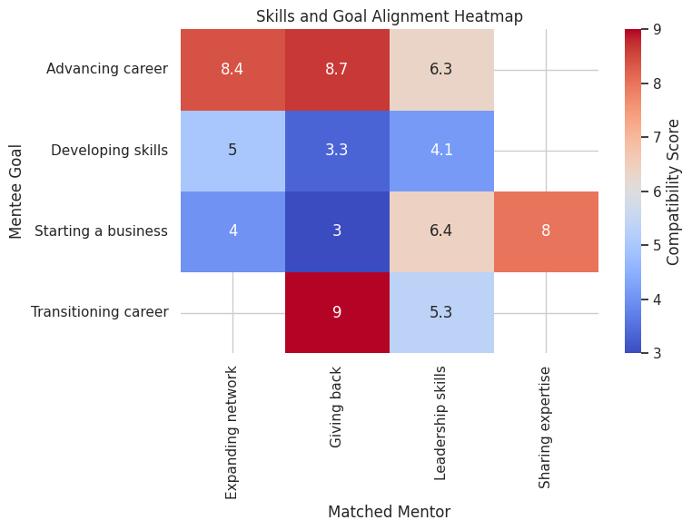
Skills & Goal Alignment
Dark red: Strong alignment between mentor skills and mentee goal.
Light red: Moderate alignment.
Light blue: Weak alignment.
Dark blue: Very weak alignment.

Slide 7
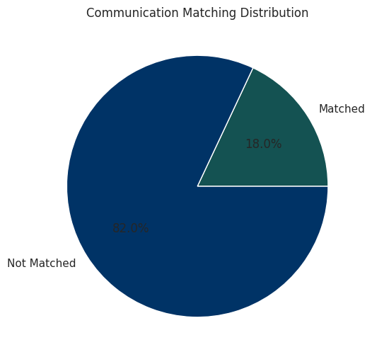
Communication & Time Commitment Analysis
Out of a total of 50 mentor-mentee pairs, there were 9 communication matches, accounting for 18.00% of the pairs, and 12 time commitment matches, representing 24.00% of the pairs.

Slide 8
Assumptions
1. Importance Variation: Gather participant data to determine the significance of different matching factors rather than assuming equal importance.
2. Profile Updates: Enable regular updates to mentor and mentee profiles to capture evolving skills and goals.
3. Diversity Consideration: Promote diversity and inclusion in pairings by assessing potential biases and encouraging varied matches.
Improvements to the Algorithm
1. Dynamic Weighting: Adjust weights based on mentor and mentee feedback to improve match quality.
2. Machine Learning Integration: Use machine learning to predict compatibility from historical successful pairings.
3. Feedback Loop: Gather post-mentorship feedback to continually refine the matching process.

Slide 9
THE END
"The future is not about competing with machines but partnering with them using data and AI."
Unknown

